Slide 1

Car price prediction
Submitted by,
Nidhi Gupta
Inshipship 16

Slide 2
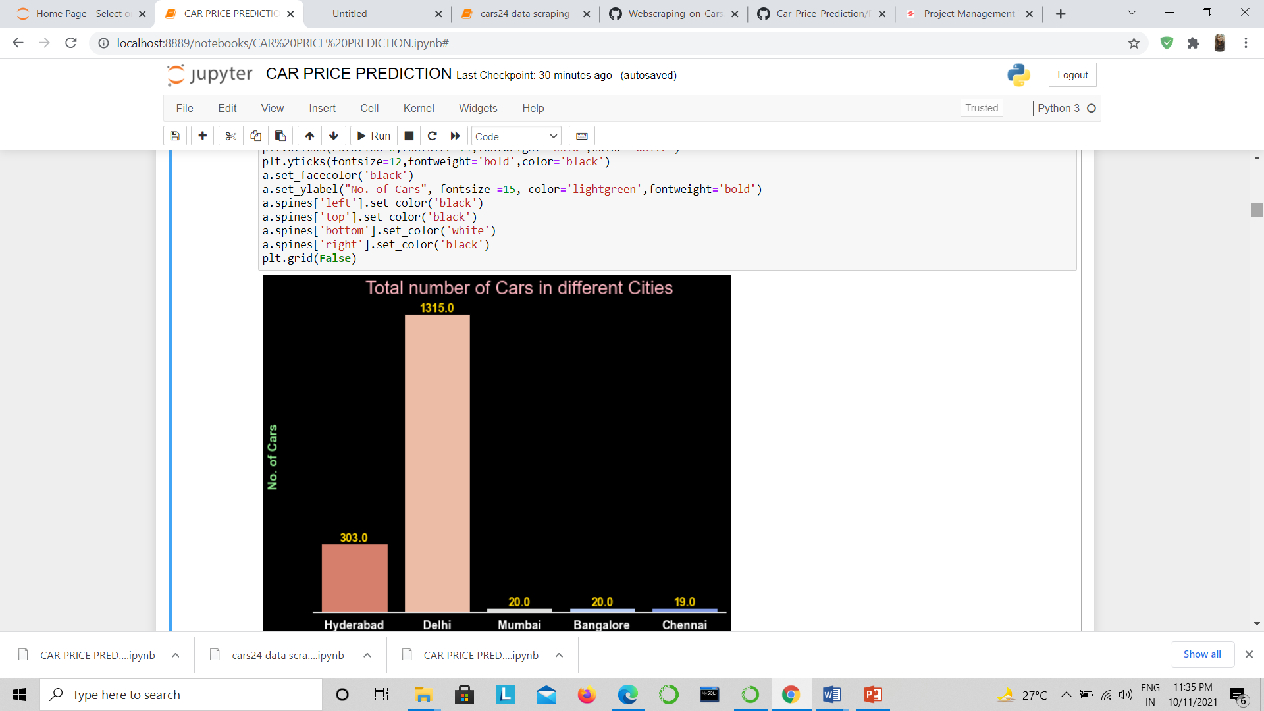
1) Total number of cars in different Cities

Slide 3
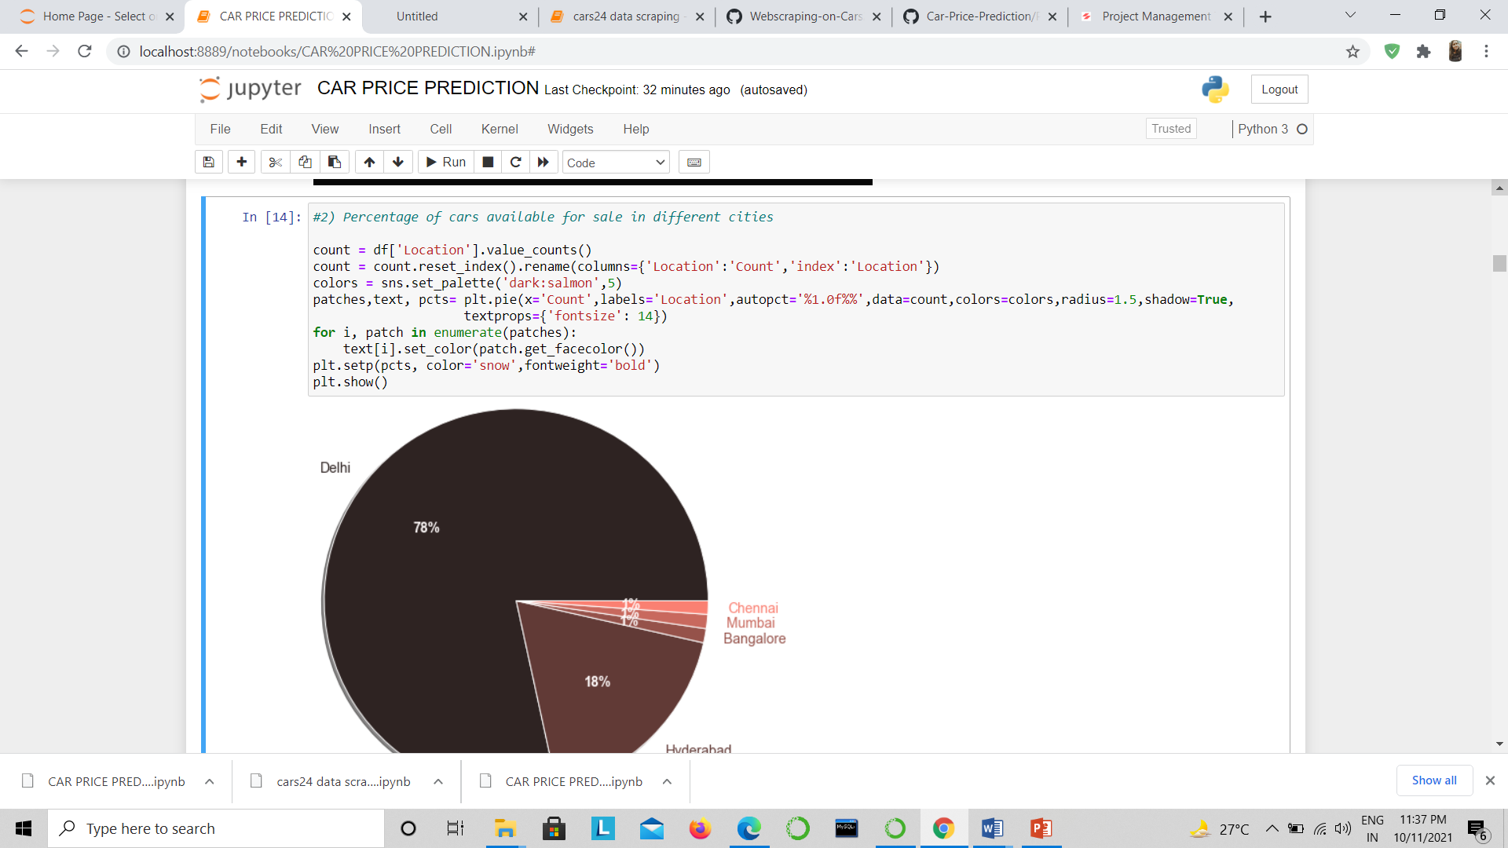

Slide 4
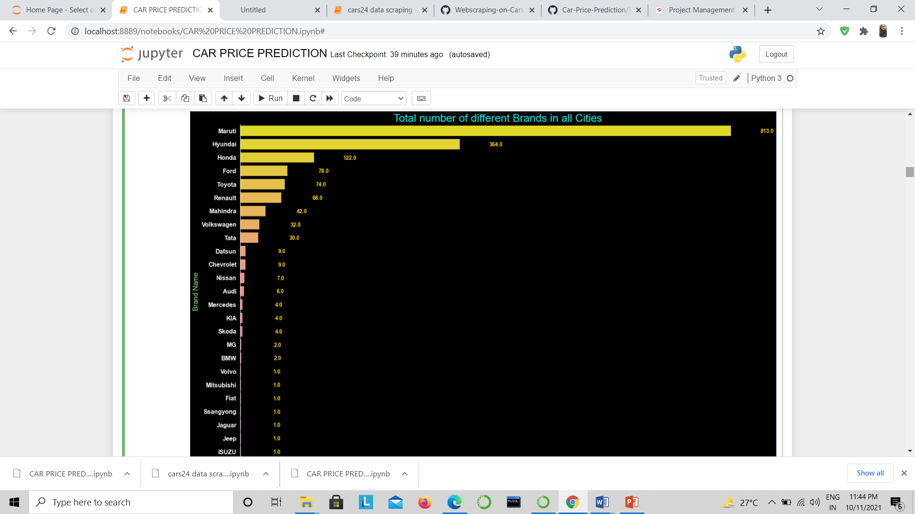
3) No. of different Brands in all Cities

Slide 5
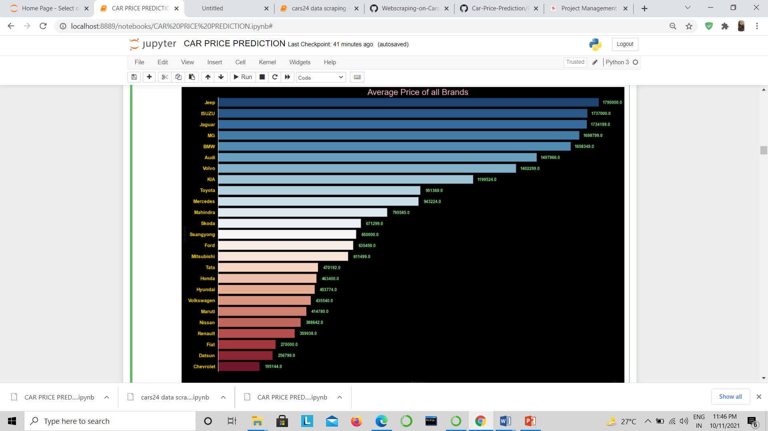
4) Average Price of all the brands

Slide 6
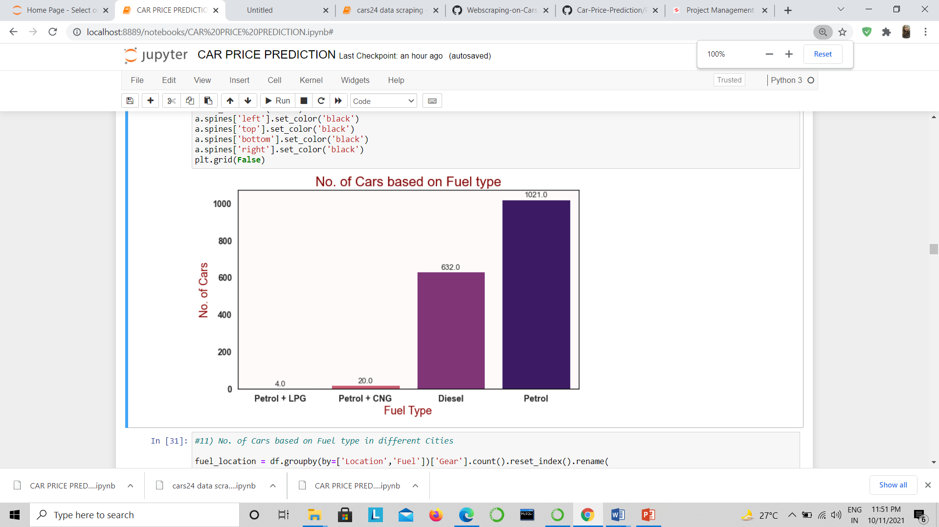
Number of Cars based on Fuel type in all cities

Slide 7
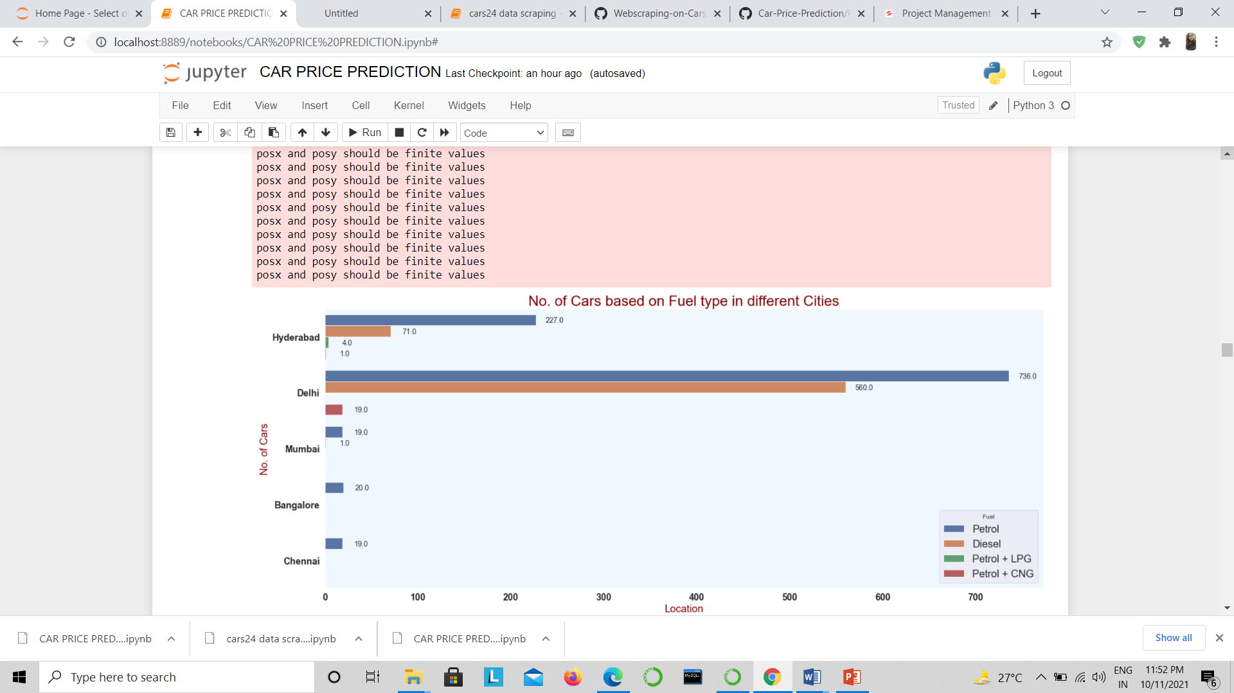
No. of Cars based on Fuel type in different Cities

Slide 8
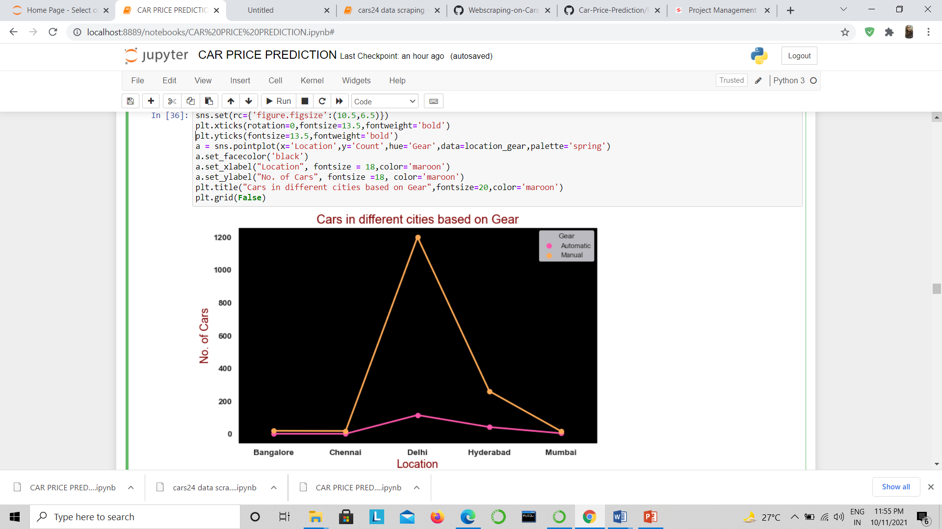
No. of cars in different Cities based on Model Year

Slide 9
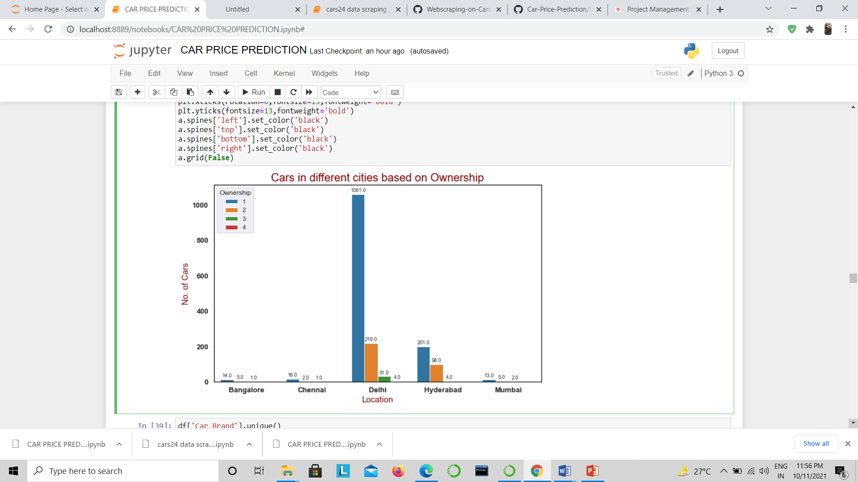
No. of Cars in different cities based on Ownership

Slide 10
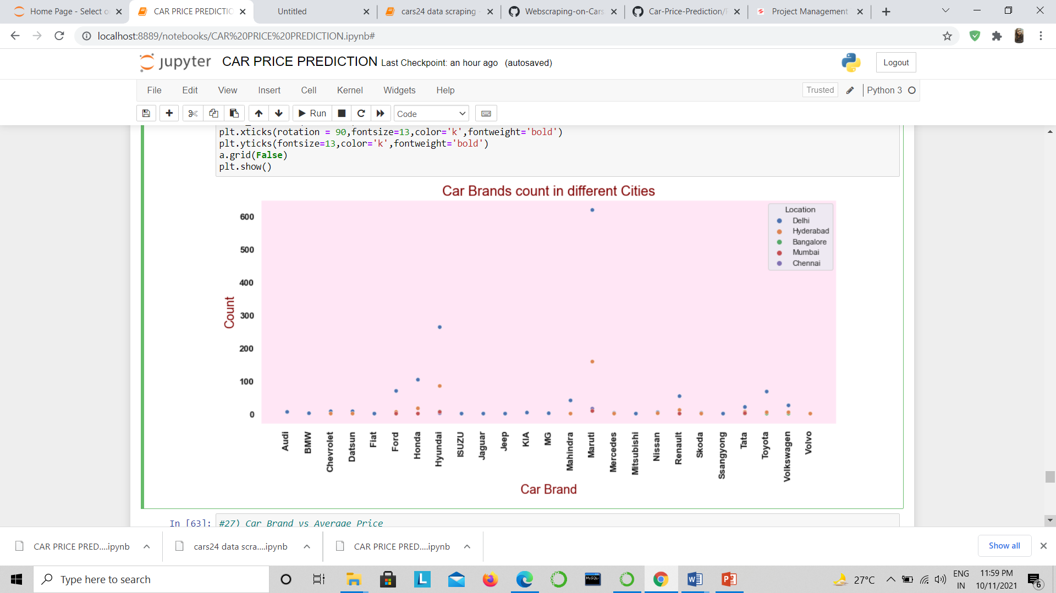
Comparision of car brand count in different Cities

Slide 11
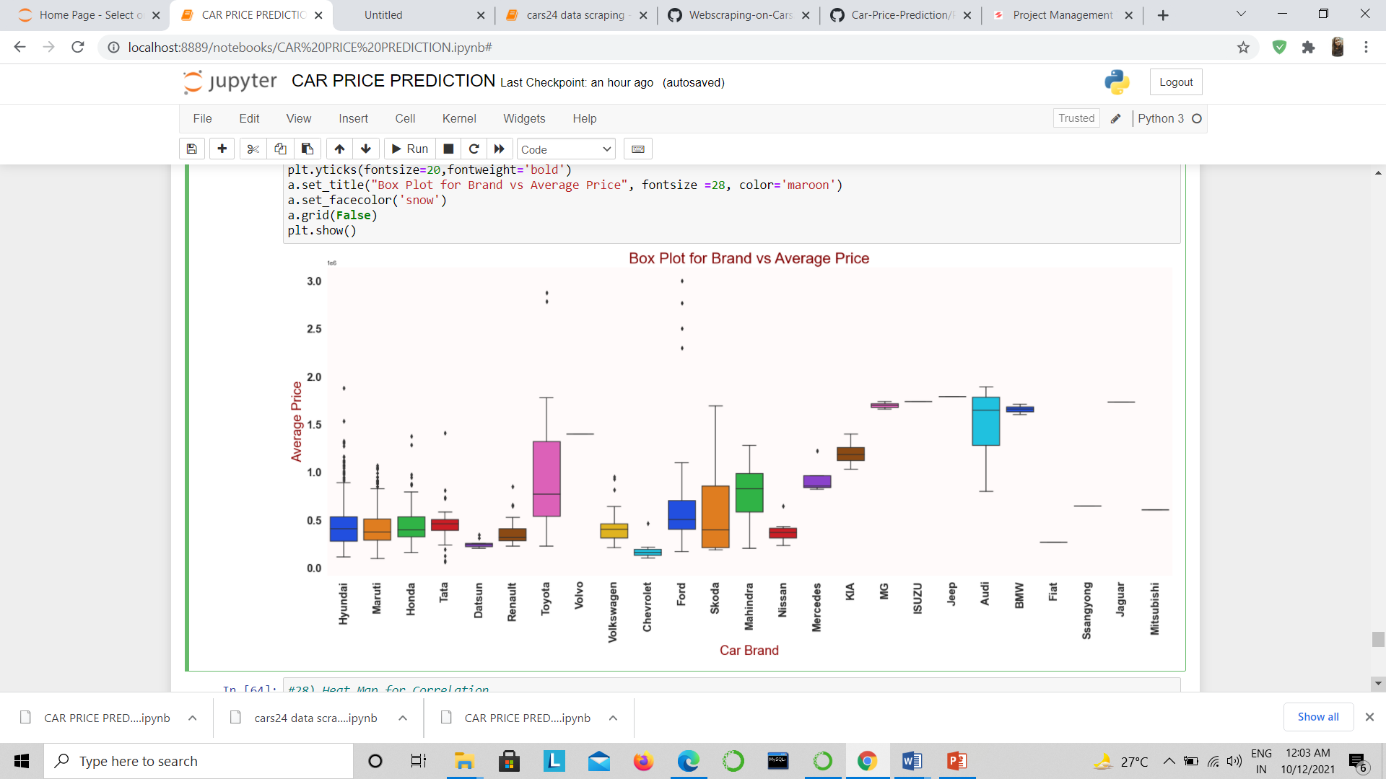
Car Brand vs Average Price

Slide 12
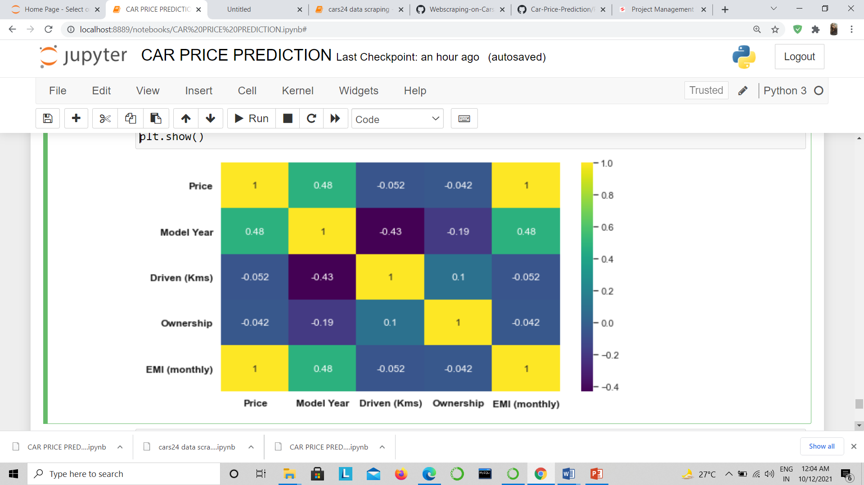
Heat Map for Correlation

